Slide 1
Overall
Description of background
With Celgene successfully integrated with BMS Japan, as well as re-organization of existing business unit of Oncology, changes are required for tracking prescription data in order to enhance patients’ experience and strengthen commercial capabilities. General situation of prescription data tracking for japan market is as below.
What is happened:
  ONO alliance - ONO is going to track prescription data of ONC1 products at patient level.
  Business unit re-organization - EMPLICITI, SPRYCEL,OP HL have been moved from ONC2 to Hema new BU.
What is current situation:
  Oncology BU is divided into 2 sales orgs, ONC1 and ONC2.Respectively in charge of promoting products in slide 2.
  ONC2 products as well as EMPLICITI, SPRYCEL,OP HL using Patient prescription follow up to track patient level data
  ONC1 products using monthly Advanced survey to collect number-based prescription data and exchange data with ONO
What is needed:
  ONC1 products to use patient prescription follow up
  Remove EMPLICITI, SPRYCEL,OP HL from current ONC page

Slide 2
Products promoted by ONC1/ONC2
As is
ONC1
OPDIVO LUNG
OPDIVO RCC
OPDIVO+YERVOY RCC
OPDIVO H&N
OPDIVO MELANOMA
OPDIVO+YERVOY MELANOMA
YERVOY
ONC2
OPDIVO GC
OPDIVO ESOPHAGEAL
OPDIVO CRC
OPDIVO+YERVOY CRC

Slide 3
As is
Prescription follow up overview by function
Patient level Prescription follow up
Monthly Advanced Survey for follow up
General Survey for follow up
IM
ONC2
ONC1
hCLG products

Slide 4
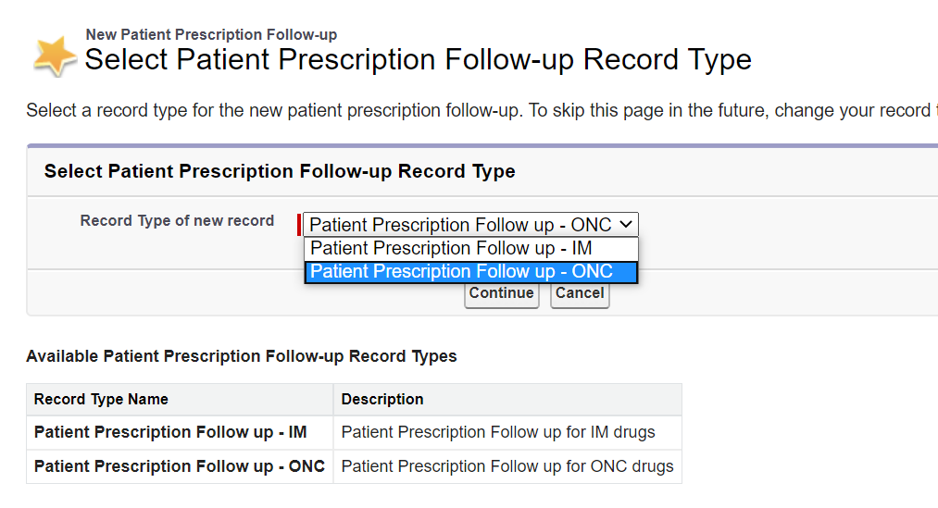
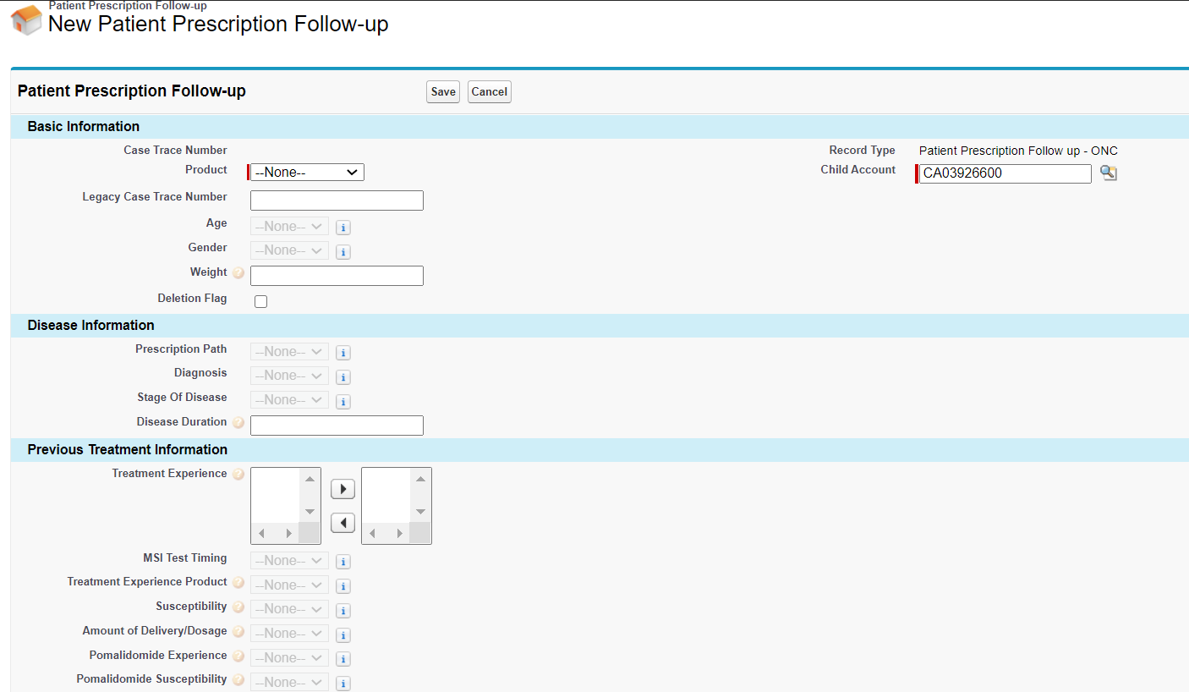
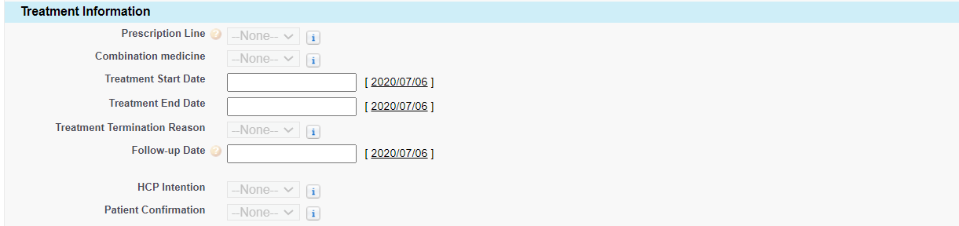
As is
Patient level prescription follow up(input page)

Slide 5

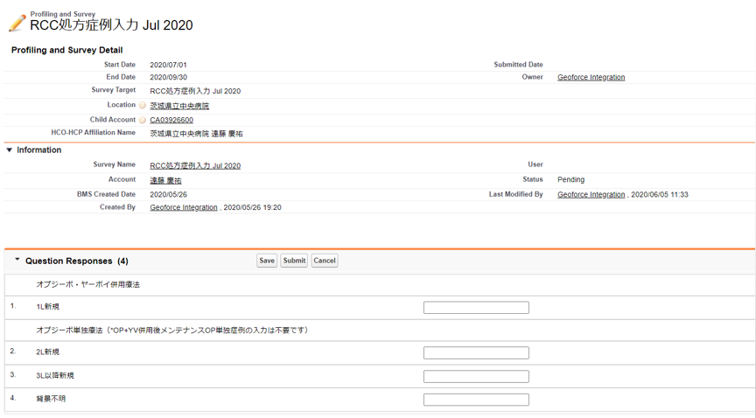
As is
Monthly Advanced survey
Create survey for each TA of ONC1
Upload target doctor list
Distribute survey to child account related list
Gather number-based prescription data from HCPs
Reach out to survey target account page
Record data

Slide 6
Problem Statement
Potentially Problems
Integrity
EM/SP/OP HL remains on ONC page while these products have been moved to Hema
Product picklist value OPDIVO EC which is in use, does not match downstream C-SCOR report criteria, leading a data leakage of OPDIVO ESOPHAGEAL prescription data in C-SCOR report.
Limitation
Need to upload survey target list every month. Preparing survey target list involves field workers, FFE team, support team. FFE team confirm Dr. information collected from field and provide a list to support team. Support team then process the list to a CSV file to upload. This brings high lead time and extra workload to all parties involved.
Alliance
ONO is considering to track prescription data at patient level .However, Advanced survey providing number-based data will not satisfy this demand.

Slide 7
Requirement
Solutions
ONC1
Use patient prescription follow up instead advanced survey
ONC2
Remove/partially remove fields/dependencies from ONC page
Change product picklist value OPDIVO EC to OPDIVO ESOPHAGEAL

Slide 8
Requirement
High level overview of Asis/Tobe
Asis
Tobe
Patient prescription follow
Patient prescription follow
IM page
IM Page
ONC2 page
No change
Monthly advanced survey
ONC Page
ONC1
Add ONC1 products to
ONC page
General survey
Hema Page
Add hCLG products to Hema page
hCLG
Remove SP/EM/OP HL from ONC2 to Hema page

Slide 9
Business justification
As EM/SP/OP HL have been moved FROM ONC2 to Hema, it is necessary to remove these products from product picklist value as well as related fields/dependencies on page which are used specially for EM/SP/OP HL on ONC page
For strategic alliance purpose, BMS and ONO need to share prescription data as a proof of co-promotion partnering activities. ONO is going to track prescription data at patient level .However, Advanced survey providing number-based data will not satisfy this demand. Besides, ONO requires to track new prescription data of OPDIVO GC
Survey target list uploading happens every month. Preparing survey target list involves field workers, FFE team, support team. FFE team confirm Dr. information collected from field and provide a list to support team. Support team then process the list to a CSV file to upload. This brings high lead time and extra workload to all parties involved.
For analysis purpose, business requires to be able to track prescription data by therapeutic areas

Slide 10
Request
Remove EM/SP/OP HL from current ONC screen product pick list value as well as fields/dependencies that are not used for other products in ONC page
Add ONC1 products to current ONC screen product pick list value as well as related fields/dependencies
Add new attribute Therapeutic Area for marketing analysis purpose
Add new attributes for tracking OP GC prescription data based on ONO alliance
Change product picklist value OPDIVO EC to OPDIVO ESOPHAGEAL as CPM standard
No need to migrate advanced survey historical data. However reports regarding advanced survey should be left for reference
Adjust Prescription follow up report for ONC to cover new attributes

Slide 11
Appendix
TA/Product list
ONC | LC | OPDIVO LUNG
 | RCC | OPDIVO RCC
 |  | OPDIVO+YERVOY RCC
 | H&N | OPDIVO H&N
 | GC | OPDIVO GC
 | EC | OPDIVO ESOPHAGEAL
 | CRC | OPDIVO CRC
 |  | OPDIVO+YERVOY CRC
 | Mela | OPDIVO MELANOMA
 |  | OPDIVO+YERVOY MELANOMA
 |  | YERVOY

